Slide 1
Presentation brief for MCT’s
Title of presentation | End-to-end security with Azure Synapse Analytics
Presentation\Lab length | Presentation: 50 - 60 minutes Lab: 50 – 60 minutes
Audience | Data Engineers, Data Scientists, Data Professionals, Data Architects, BI Professionals, Developers
Purpose | Understand the security options for securing data warehouses in Azure Synapse Analytics Understand how to work with Azure Key Vault to support your security implementations How to secure sensitive data within Azure Synapse Analytics
(think) Student key takeaways | The student should appreciate what networking security should be setup to protect a data warehouse The student should be able to retrieve keys from Azure Key Vault to use to secure a data warehouse The student should be able to use column and row level security to protect data The student will be able to use dynamic data masking to protect confidential data
(feel) Student desired mindset | The student may feel that parts of this work is not within their remit. That may be true and should be acknowledged The student may feel that they need to understand Azure Key Vault better and how it can help The student may feel they may be company and industry policies that impact their security
(do) Student outcomes | The student should be able retrieve keys from an Azure Key Vault The student should be able to protect a data warehouse and a pipelines that populate it The students should be able to protect confidential data
More information | For MCT course feedback, visit the Microsoft Official Courseware forum
Notes:
Instructor notes and guidance
This slide is for MCT use only, outlining the aims and objectives of this module.

Slide 2
DP-203T00: End-to-end security with Azure Synapse Analytics
Notes:
Instructor notes and guidance
This is not the first time that you will have covered security in this course, you would have looked at this in depth in module 4: Run interactive queries using Azure Synapse Analytics serverless SQL pools. It is important to call out to the student that in that module, much of the security was focussed on data lake security, as well as the authentication and authorization options available in Azure Synapse Analytics serverless SQL pools to provide a layered approach.
It’s important that the students understand that in this module, the focus of the security is on the dedicated SQL pool, and the supporting technologies that can help you to provide tight security. In this module you will revisit the key security areas that you will need to implement to secure a data warehouse.
You will then explore how Azure Key Vault can be used. Tell students that Azure Key Vault can also be used with serverless SQL pool security. It is also important to tell the students that it is likely that they will not be responsible for setting this up and managing it, as this could be managed by an Azure administrator. But the students should be able to retrieve key information in Azure Key Vault and use it to access data stores in a secure way.
Finally, you will teach the students how column and row-based security can be used to control access to data in a table, and how you can use dynamic data masking to obfuscate data in order to keep the source data confidential.

Slide 3

Agenda
Lesson 01: Secure a data warehouse in Azure Synapse Analytics
Lesson 02: Configure and manage secrets in Azure Key Vault
Lesson 03: Implement compliance controls for sensitive data
Notes:
Instructor notes and guidance
This space has been left deliberately blank

Slide 4
Lesson 01: Secure a data warehouse in Azure Synapse Analytics
Notes:
Instructor notes
This space has been left deliberately blank

Slide 5
Secure a data warehouse in Azure Synapse Analytics
Network security
Identity and access management
Managing sensitive data
Encryption capabilities built into Azure
Notes:
Talking points
Security is a multi-layered approach. Data is at the core, but there are a range of technologies, processes and people that protect it. From the physical security of the buildings, to the implementation of application security. Every aspect is important.
Security is only as strong as the weakest link. A simple example could be a concept called tail-gating in the physical security layer. This involves an organization operating a policy of badged access where all members of staff only get access to building using a badge. Tailgating is when an individual access a building without badging in, instead, they rely on the person in front who has badge in to hold a door open for them. This occurrence could happen on a daily basis at work, and it may even be an accepted practice. It does however, represents a security vulnerability that could be exploited.
Instructor notes and guidance
Provide an overview of the different areas of security to consider, and also the fact that it is a team effort across the whole organization. You don’t need to go in depth here, but call out to the students that the lab will give them the opportunity to explore these areas in a hands-on way
Acknowledge the important of working with sensitive data with column and row security, as well as dynamic data masking which will be covered in depth later in this module.
Recommended reading for this slide
https://docs.microsoft.com/en-us/learn/modules/secure-data-warehouse-azure-synapse-analytics/

Slide 6
Network security
Securing your network from attacks and unauthorized access is an important part of any architecture
Internet protection
Firewalls
DDoS protection
Network security groups
Assess the resources that are internet-facing, and to only allow inbound and outbound communication where necessary. Make sure you identify all resources that are allowing inbound network traffic of any type
To provide inbound protection at the perimeter, there are several choices:
Azure Firewall
Azure Application Gateway
Azure Storage Firewall
The Azure DDoS Protection service protects your Azure applications by scrubbing traffic at the Azure network edge before it can impact your service’s availability
Network Security Groups allow you to filter network traffic to and from Azure resources in an Azure virtual network. An NSG can contain multiple inbound and outbound security rules
Notes:
Talking points
Provide an overview of the four areas of network security as shown on the slide:
Internet protection
Firewalls
DDoS protection
Network security groups
Instructor notes and guidance
Inform the students that for in-depth understanding of network security, an understanding of IP addresses, protocol and the technologies would be required to manage this. It would be difficult to learn all of this, as well as the Data Engineering responsibilities that the students have. You should be familiar of firewall configurations of data services, but you should work with a Security Administrator when it comes to considering DDOS and Network Security group management.
Recommended reading for this slide
https://docs.microsoft.com/en-us/learn/modules/secure-data-warehouse-azure-synapse-analytics/2-understand-network-security-options
https://docs.microsoft.com/en-us/learn/modules/secure-data-warehouse-azure-synapse-analytics/3-configure-conditional-access

Slide 7
Identity and access
Authentication
This is the process of establishing the identity of a person or service looking to access a resource. Azure Active Directory is a cloud-based identity service that provide this capability
Azure Active Directory features
Single sign-on
Enables users to remember only one ID and one password to access multiple applications
Apps & device management
You can manage your cloud and on-premises apps and devices and the access to your organizations resources
Identity services
Manage Business to business (B2B) identity services and Business-to-Customer (B2C) identity services
Authorization
This is the process of establishing what level of access an authenticated person or service has. It specifies what data they're allowed to access and what they can do with it. Azure Active Directory also provides this capability
Notes:
Talking points
Authentication is the process of establishing the identity of a person or service looking to access a resource. Azure Active Directory is a cloud-based identity service that provide this capability.
Authorization is the process of establishing what level of access an authenticated person or service has. It specifies what data they're allowed to access and what they can do with it. Azure Active Directory also provides this capability.
Instructor notes and guidance
Many of your students will likely be aware of authentication and authorization. If not, make sure that they are familiar with the basic concepts. Be aware, that they may consider this in the context of user accounts, therefore its important to point out that this can occur through other methods as well such as Shared Access Key for storage accounts. From a user and service account perspective, go into the benefits of Azure Active Directory, and how it can be used to manage devices and apps too.
Recommended reading for this slide
https://docs.microsoft.com/en-us/learn/modules/secure-data-warehouse-azure-synapse-analytics/4-configure-authentication

Slide 8
Encryption
Encryption at rest
Data at rest is the data that has been stored on a physical medium. This could be data stored on the disk of a server, data stored in a database, or data stored in a storage account
Encryption on Azure
Raw encryption
Enables the encryption of:
Azure Storage
V.M. Disks
Disk Encryption
Database encryption
Enables the encryption of databases using:
Transparent Data Encryption
Encrypting secrets
Azure Key Vault is a centralized cloud service for storing your application secrets
Encryption in transit
Data in transit is the data actively moving from one location to another, such as across the internet or through a private network. Secure transfer can be handled by several different layers
Notes:
Talking points
Encryption at rest is the data that has been stored on a physical medium. This could be data stored on the disk of a server, data stored in a database, or data stored in a storage account.
Encryption in transit is the data actively moving from one location to another, such as across the internet or through a private network. Secure transfer can be handled by several different layers
Instructor notes and guidance
This provides a holistic view of encryption within Azure, not just focused on database encryption. Understanding the difference between encryption at rest v encryption in transit is a good example of providing end to end security of data. Not just in the storage, but also in the transmission of data too.
Recommended reading for this slide
https://docs.microsoft.com/en-us/learn/modules/secure-data-warehouse-azure-synapse-analytics/8-implement-encryption

Slide 9
Lesson 01: Configure and manage secrets in Azure Key Vault
Notes:
Instructor notes
This space has been left deliberately blank

Slide 10
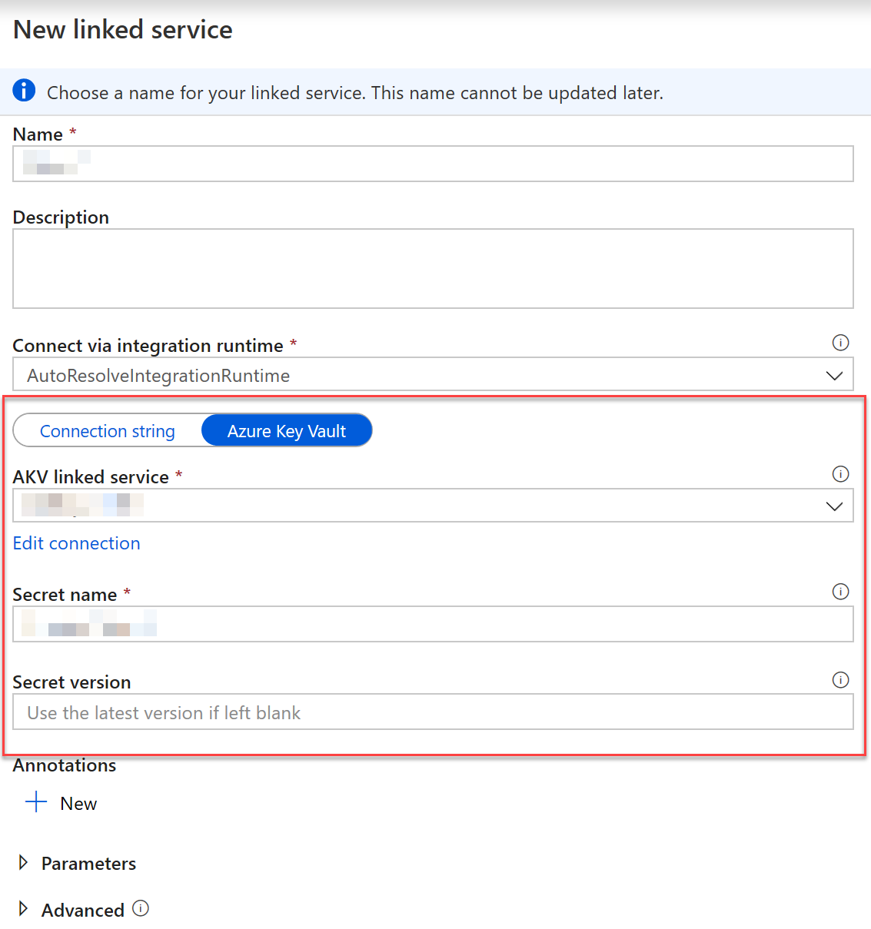
Configure and manage secrets in Azure Key Vault
Azure Key Vault protects
Secrets
Keys
Certificates
Data Engineers are typically concerned with accessing the data contained in Key Vault to apply to linked services
Notes:
Talking points
Storing and handling secrets, encryption keys, and certificates directly is risky, and every usage introduces the possibility of unintentional data exposure. Azure Key Vault provides a secure storage area for managing all your app secrets so you can properly encrypt your data in transit or while it's being stored.
Azure Key Vault is a centralized cloud service for storing application secrets such as encryption keys, certificates, and server-side tokens. Key Vault helps you control your applications' secrets by keeping them in a single central location and providing secure access, permissions control, and access logging.
You use Azure Key Vault to create multiple secure containers, called vaults. Vaults help reduce the chances of accidental loss of security information by centralizing application secrets storage.
Keys are the central actor in the Azure Key Vault service. A given key in a key vault is a cryptographic asset destined for a particular use such as the asymmetric master key of Microsoft Azure RMS, or the asymmetric keys used for SQL Server TDE (Transparent Data Encryption), CLE (Column Level Encryption) and Encrypted backup.
Secrets are small (less than 10K) data blobs protected by a HSM-generated key created with the Key Vault. Secrets exist to simplify the process of persisting sensitive settings that almost every application has: storage account keys, .PFX files, SQL connection strings, data encryption keys, etc. Azure Key Vault is also a service that lets you easily provision, manage, and deploy public and private SSL/TLS certificates for use with Azure and your internal connected resources.
Instructor notes and guidance
For everything that you can discuss about Azure Key Vault, for the purpose of the DP-203 certification, you need to know that it exists and how you can access secrets in an Azure Key Vault via a linked service. This is reason why the graphic shows this. Creating and managing Azure Key Vault is part of the Azure Administrator certification.
Recommended reading for this slide
https://docs.microsoft.com/en-us/learn/modules/configure-and-manage-azure-key-vault/
https://docs.microsoft.com/en-us/azure/key-vault/key-vault-overview

Slide 11
Lesson 01: Implement compliance controls for sensitive data
Notes:
Instructor notes
This space has been left deliberately blank

Slide 12
Managing sensitive data
Column level
security
GRANT SELECT ON wwi_security.Sale([ProductID], [Analyst], [Product], [CampaignName],[Quantity], [Region], [State], [City], [RevenueTarget]) TO DataAnalystMiami;
Row level
security
CREATE FUNCTION wwi_security.fn_securitypredicate(@Analyst AS sysname)
RETURNS TABLE
WITH SCHEMABINDING
AS
RETURN SELECT 1 AS fn_securitypredicate_result
WHERE @Analyst = USER_NAME() OR USER_NAME() = 'CEO'
GO
CREATE SECURITY POLICY SalesFilter
ADD FILTER PREDICATE wwi_security.fn_securitypredicate(Analyst)
ON wwi_security.Sale
WITH (STATE = ON);
GRANT SELECT ON wwi_security.Sale TO CEO, DataAnalystMiami, DataAnalystSanDiego;
Notes:
Talking points
Column and row level security, is used in many types of databases in Azure; including Azure SQL Database through to Azure Synapse Analytics. This may be familiar territory for some of your students.
Column-level security simplifies the design and coding of security in your application, allowing you to restrict column access to protect sensitive data. For example, ensuring that specific users can access only certain columns of a table pertinent to their department.
Row-Level Security (RLS) simplifies the design and coding of security in your application. RLS helps you implement restrictions on data row access. For example, you can ensure that workers access only those data rows that are pertinent to their department. Another example is to restrict customers' data access to only the data relevant to their company.
The access restriction logic is located in the database tier rather than away from the data in another application tier. The database applies the access restrictions every time data access is attempted from any tier. This restriction makes your security more reliable and robust by reducing the surface area of your overall security system. In addition, column-level security also eliminates the need for introducing views to filter out columns for imposing access restrictions on the users.
Instructor notes and guidance
Provide an overview of Column and row level security, by running through the code example on the slide
Recommended reading for this slide
https://docs.microsoft.com/en-us/learn/modules/secure-data-warehouse-azure-synapse-analytics/5-manage-authorization-through-column-row-level-security
https://docs.microsoft.com/en-us/learn/modules/secure-data-warehouse-azure-synapse-analytics/6-exercise-manage-authorization-through-column-row-level-security
https://docs.microsoft.com/en-us/azure/synapse-analytics/sql-data-warehouse/column-level-security?view=sql-server-ver15
https://docs.microsoft.com/en-us/sql/relational-databases/security/row-level-security

Slide 13
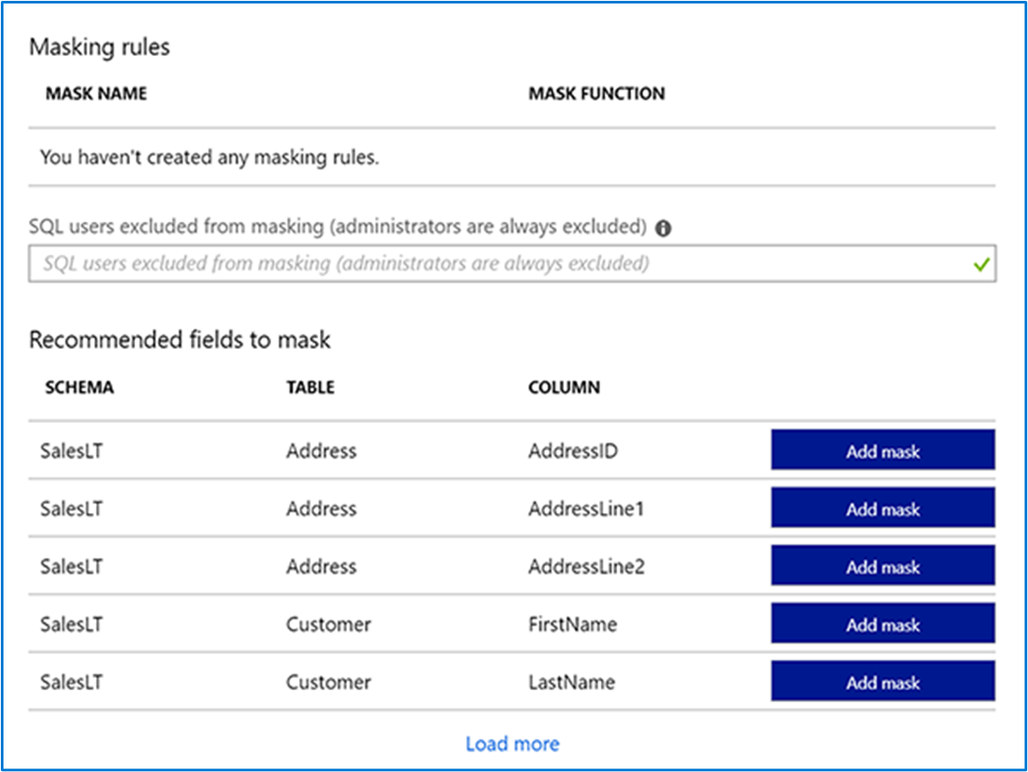
Implement compliance controls for sensitive data
Dynamic data masking
Notes:
Talking points
Dynamic data masking is also used in many types of databases in Azure; including Azure SQL Database through to Azure Synapse Analytics. This may be familiar territory for some of your students.
Dynamic data masking helps prevent unauthorized access to sensitive data by enabling customers to designate how much of the sensitive data to reveal with minimal impact on the application layer. It’s a policy-based security feature that hides the sensitive data in the result set of a query over designated database fields, while the data in the database is not changed.
Instructor notes and guidance
Use the example of a service representative at a call center who might identify a caller by confirming several characters of their email address, but the complete email address shouldn't be revealed to the service representative. A masking rule can be defined that masks all the email address in the result set of any query. As another example, an appropriate data mask can be defined to protect personal data, so that a developer can query production environments for troubleshooting purposes without violating compliance regulations.
Recommended reading for this slide
https://docs.microsoft.com/en-us/learn/modules/secure-data-warehouse-azure-synapse-analytics/7-manage-sensitive-data

Slide 14
Review questions
Q01 – Which TCP ports should be configured on your network and computer to allow Azure Synapse Studio to work?
A01 – TCP Port 80, 443 and 1443
Q02 – Which Azure Key Vault object stores storage account key information?
A02 – Secrets
Q03 – Encrypted communication is turned on automatically when connecting to Azure Synapse Analytics. True or False?
A03 – True
Notes:
Instructor notes and guidance
This space has been left deliberately blank

Slide 15
Lab: Run interactive queries using Azure Synapse Analytics serverless SQL pools
Notes:
Instructor notes and guidance
This space has been left deliberately blank

Slide 16
Lab overview
In this lab, students will learn how to secure a Synapse Analytics workspace and its supporting infrastructure. The student will observe the SQL Active Directory Admin, manage IP firewall rules, manage secrets with Azure Key Vault and access those secrets through a Key Vault linked service and pipeline activities. The student will understand how to implement column-level security, row-level security, and dynamic data masking when using dedicated SQL pools.
Lab objectives
After completing this lab, you will be able to:
Securing Azure Synapse Analytics supporting infrastructure
Securing the Azure Synapse Analytics workspace and managed services
Securing Azure Synapse Analytics workspace data
Notes:
Instructor notes and guidance
In exercise 1, Azure Synapse Analytics is a powerful solution that handles security for many of the resources that it creates and manages. In order to run Azure Synapse Analytics, some foundational security measures need to be put in place to ensure the infrastructure that it relies upon is secure. In this exercise, we will walk through securing the supporting infrastructure of Azure Synapse Analytics. You will secure Azure Synapse Analytics supporting infrastructure involving the management of the SQL Active Directory Admin account and manage the firewall access.
In exercise 2, when dealing with connectivity to external data sources and services, sensitive connection information such as passwords and access keys should be properly handled. It is recommended that this type of information be stored in an Azure Key Vault. Leveraging Azure Key Vault not only protects against secrets being compromised, it also serves as a central source of truth; meaning that if a secret value needs to be updated (such as when cycling access keys on a storage account), it can be changed in one place and all services consuming this key will start pulling the new value immediately. Azure Key Vault encrypts and decrypts information transparently using 256-bit AES encryption, which is FIPS 140-2 compliant. In this exercise, you will learn how to manage this, assign Azure Key Vault into linked services and apply it to both Azure Synapse Analytics pipeline runs and dedicated SQL pools.
In exercise 3, you will implement column and row based security to protect data, as well as use Dynamic data masking to protect confidential data

Slide 17


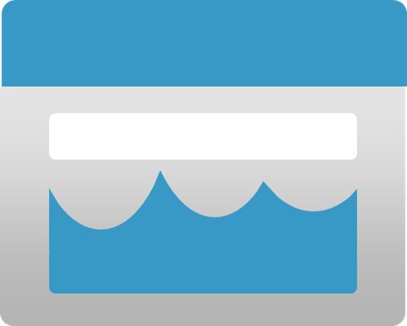








Lab 13 Overview
asacosmosdb<unique_suffix>
CosmosDB
Campaign Info
Azure Databricks
asagadatalake<unique_suffix>
Cluster
Azure Data Lake
wwi-02
Products (parquet)
dp203sql<unique_suffix>
SourceDB
Azure Synapse Analytics
Dedicated SQL Pool (SQLPool1)
Built-In Serverless SQL Pool
Apache Spark pool
Pipelines and Dataflows
Power BI
asagaworkspace<unique_suffix>
Notes:
This slide is an optional slide that you can use to show a high-level overview of the technologies used in the lab.
In this lab, students will learn how to secure a Synapse Analytics workspace and its supporting infrastructure. The student will observe the SQL Active Directory Admin, manage IP firewall rules, manage secrets with Azure Key Vault and access those secrets through a Key Vault linked service and pipeline activities. The student will understand how to implement column-level security, row-level security, and dynamic data masking when using dedicated SQL pools.

Slide 18
Lab review
Question 1 – Where do you set the SQL Active directory admin account?
Question 2 – Which UDP port should be open to use Azure Synapse Studio?
Question 3 – Which Azure Key Vault permission are required for your Azure Synapse workspace to access the values for secrets that it stores?
Question 4 – How can you set Transparent Data Encryption in Azure Synapse Analytics?
Notes:
Answers
Question 1 – You set the SQL Active directory admin account in the Azure portal, in the Synapse workspace, specifically the SQL Active directory admin property
Question 2 – UDP port 53 should be open, along with outgoing TCP ports 80, 443, and 1143
Question 3 – The Get and List permission is required for the Azure Synapse Workspace to access secrets
Question 4 – You set Transparent Data Encryption by clicking on the dedicated SQL pool, and then click Transparent Data Encryption property, and click the Data encryption button to on

Slide 19
Module summary
In this module, you have learned about:
Secure a data warehouse in Azure Synapse Analytics
Configure and manage secrets in Azure Key Vault
Implement compliance controls for sensitive data
Next steps
After the course, consider visiting [Azure security baseline for Synapse Analytics]. The Azure Security Benchmark provides recommendations on how you can secure your cloud solutions on Azure.
Notes:
Instructor notes and guidance
The next steps is suggested post course learning materials to reinforce what they have learned in the module.

Slide 20
Closing slide
Notes:
Instructor notes and guidance
This space has been left deliberately blank

